Slide 1


Multipath Opportunistic RPL Routing over IEEE 802.15.4
Bogdan Pavkovic, Fabrice Theoleyre, Andrzej Duda
MSWiM ’11: Proceedings of the 14th ACM international conference on Modeling, analysis and simulation of wireless and mobile systems
Dong Hyeon Lee
Chung-Ang University
enjoying1018@naver.com
January. 13th 2022

Slide 2
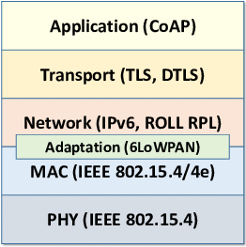
Goal of this paper
Combine RPL, IEEE 802.15.4
However, there is structural difference.

Slide 3
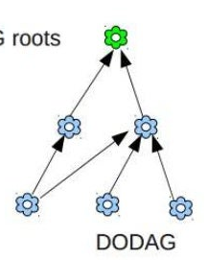
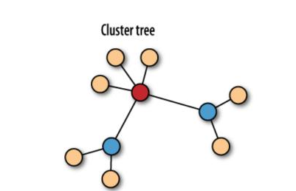
Structural difference
DODAG
(RPL)
IEEE 802.15.4
(cluster tree)

Slide 4
How to Solve ?
Modfiy MAC LAYER(Superframe, Beacon)
Beacon-only Period
Superframe Scheduling

Slide 5
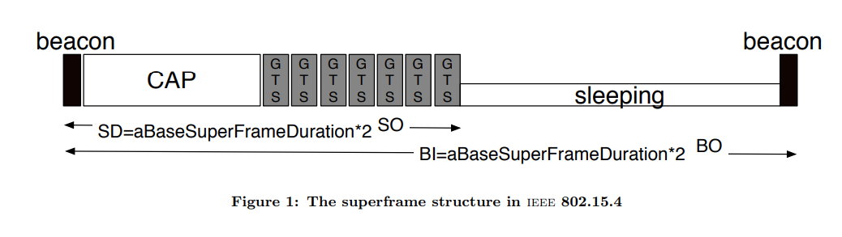
Prior Knowledge(1)
[Two modes of IEEE 802.15.4]
1) Non –beacon mode
- a classical CSMA-CA approach
receiver(client) initates communication.
Coordinator(server) have to remain awake
2) Beacon mode <-Goal

Slide 6
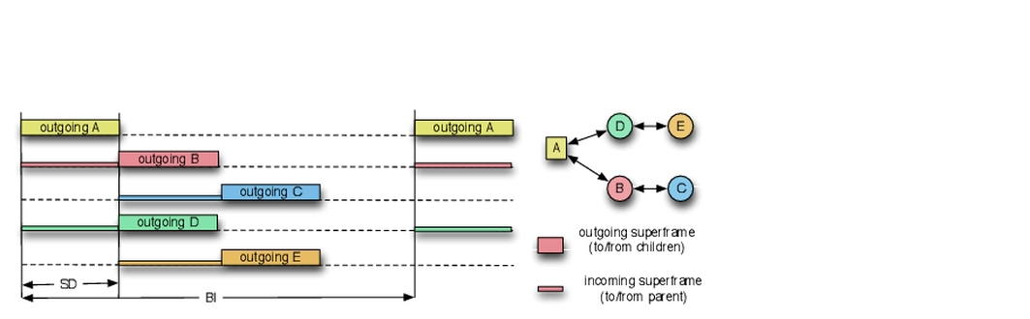
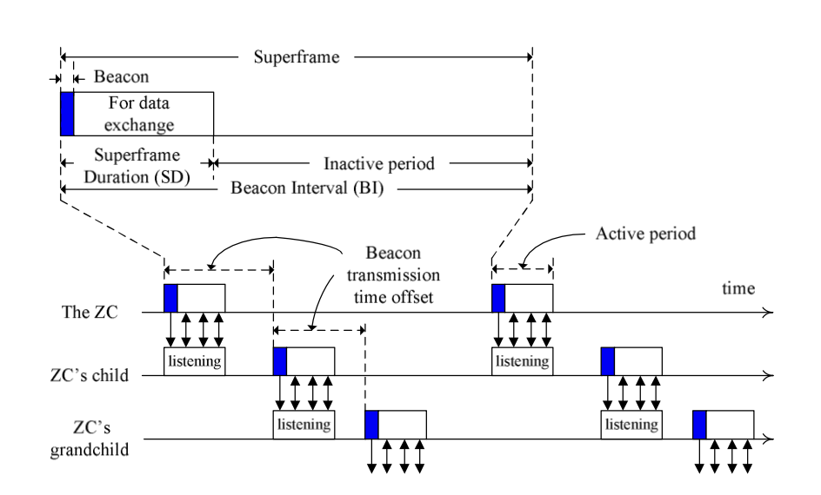
Prior Knowledge(2)
IEEE 802.15.4
A
B
C
A
DODAG
(RPL)
B
C

Slide 7
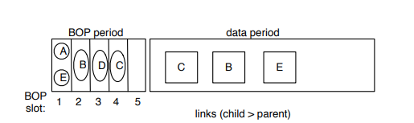
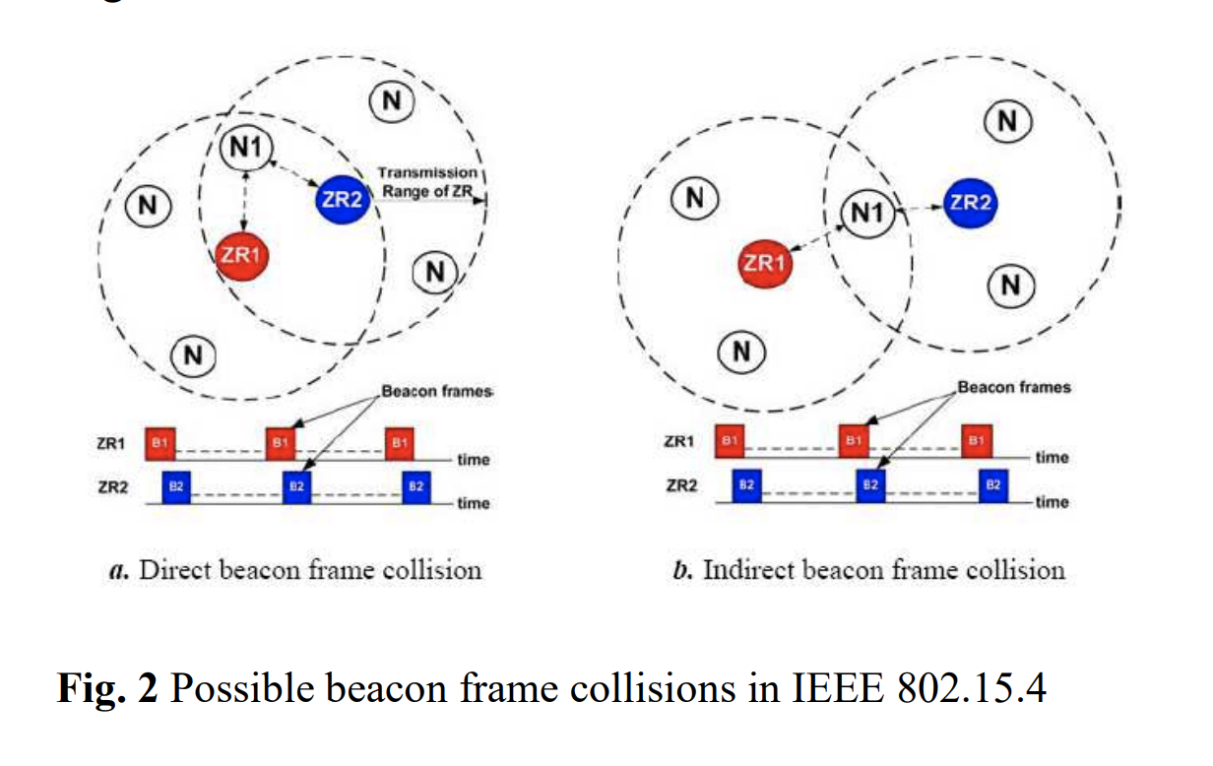
Beacon only period & Superframe scheduling
A

Slide 8
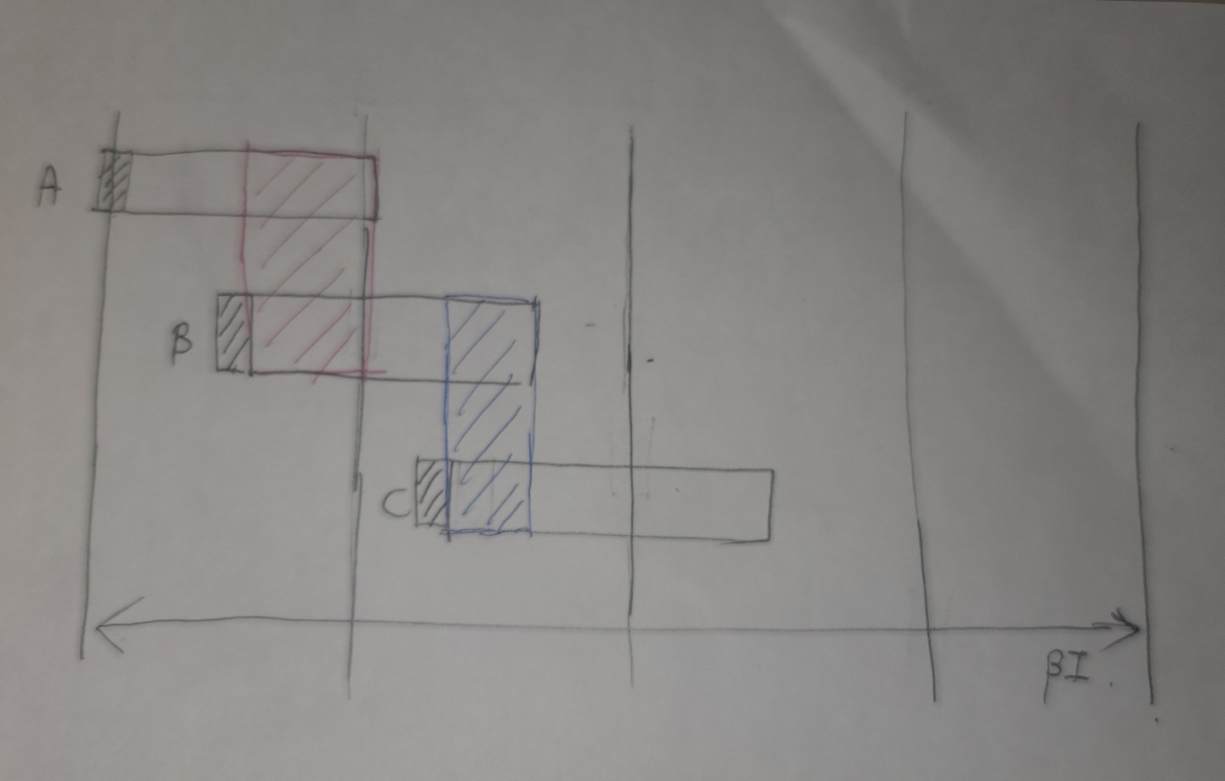
Guess(1)

Slide 9
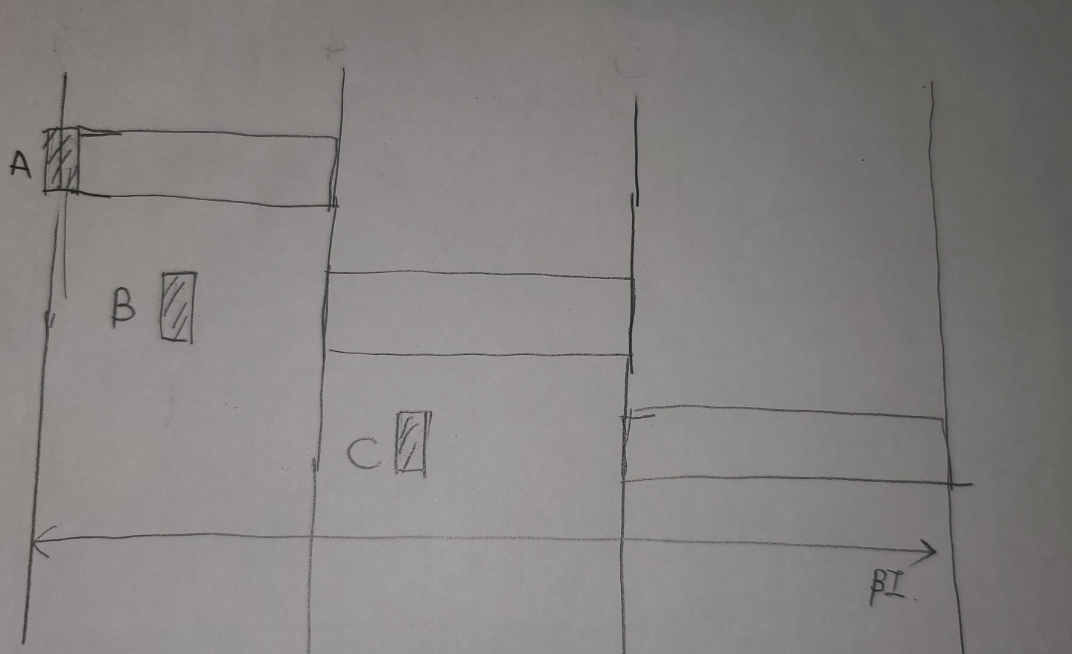
Guess(2)

Slide 10
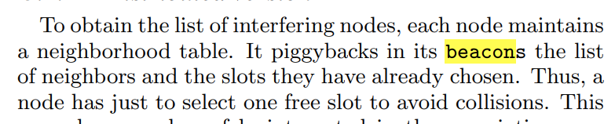
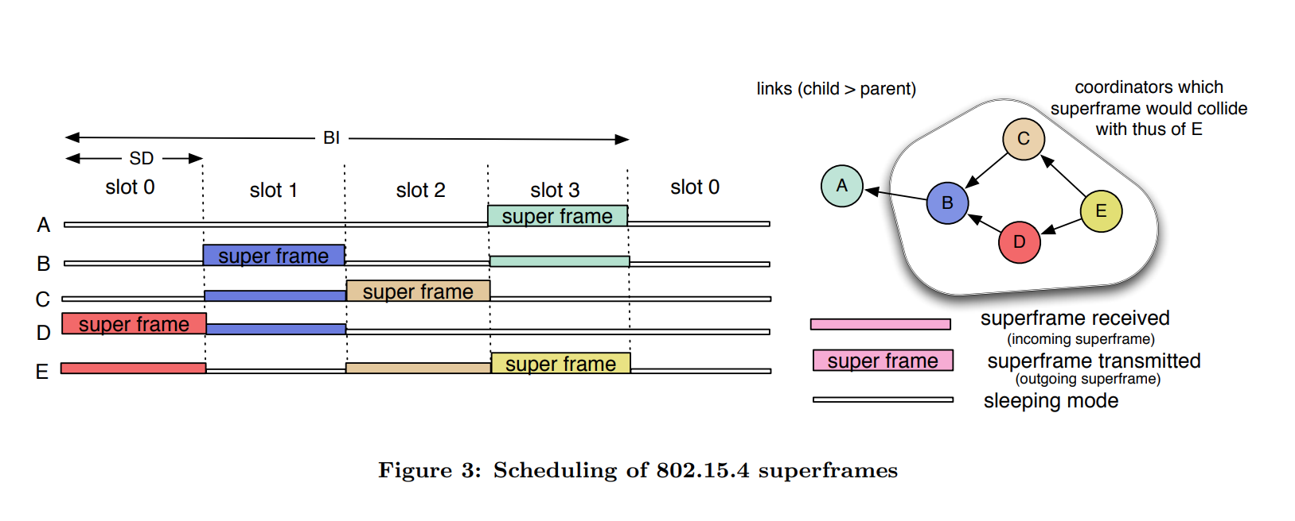
Example

Slide 11
Example(2)

Slide 12
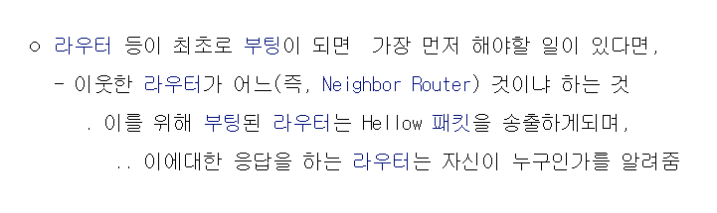
Discuss
E will collect hellos from C and D , and will be able to construct the list of its neighbors….

Slide 13
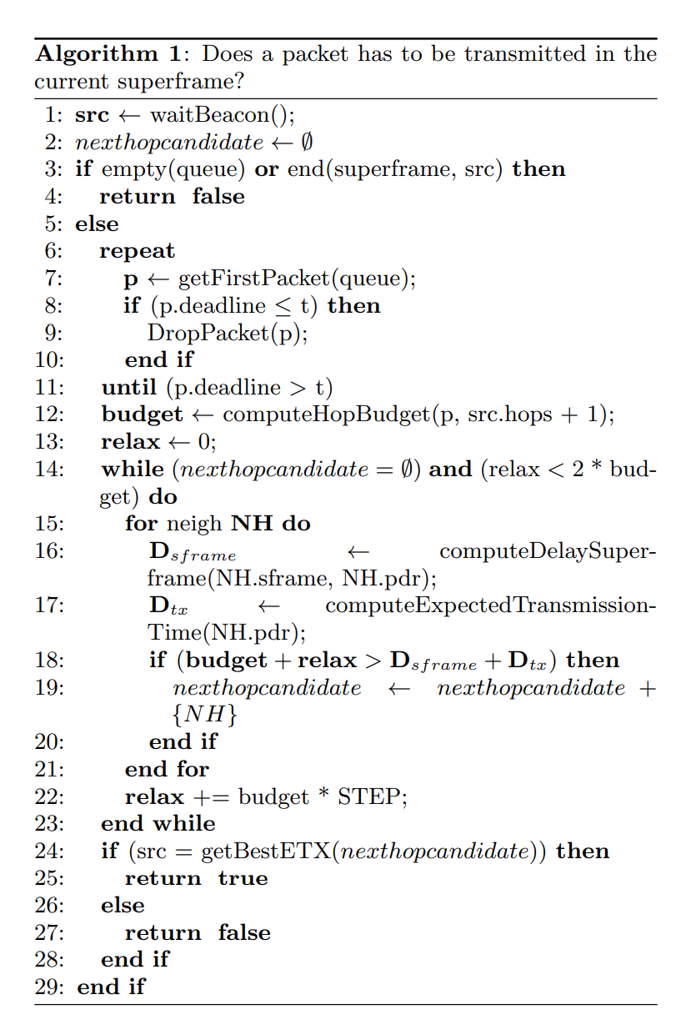
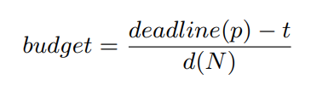
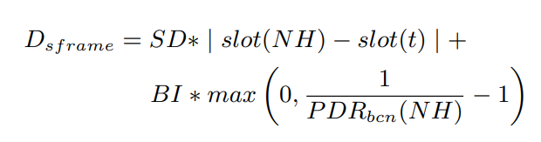


Choose a path from multipath(1) – greedy!

Slide 14
Choose a path from multipath(2) – greedy!
Budget = (보낼 패킷의 유통기한 – 현재시간) / 남은 홉수
Dsframe = 스케줄 상, 내가 보낼 때 까지 기다려야 하는 시간
Dtx = 그다음 목적지 까지 전달될 때 까지 걸리는 (예상) 시간
(1)budget < dsframe + dtx =>패킷 버림 (모든 목적지에 대해)
만족하는 것중 dsframe+dtx 가 제일 작은 목적지 고른다.

Slide 15
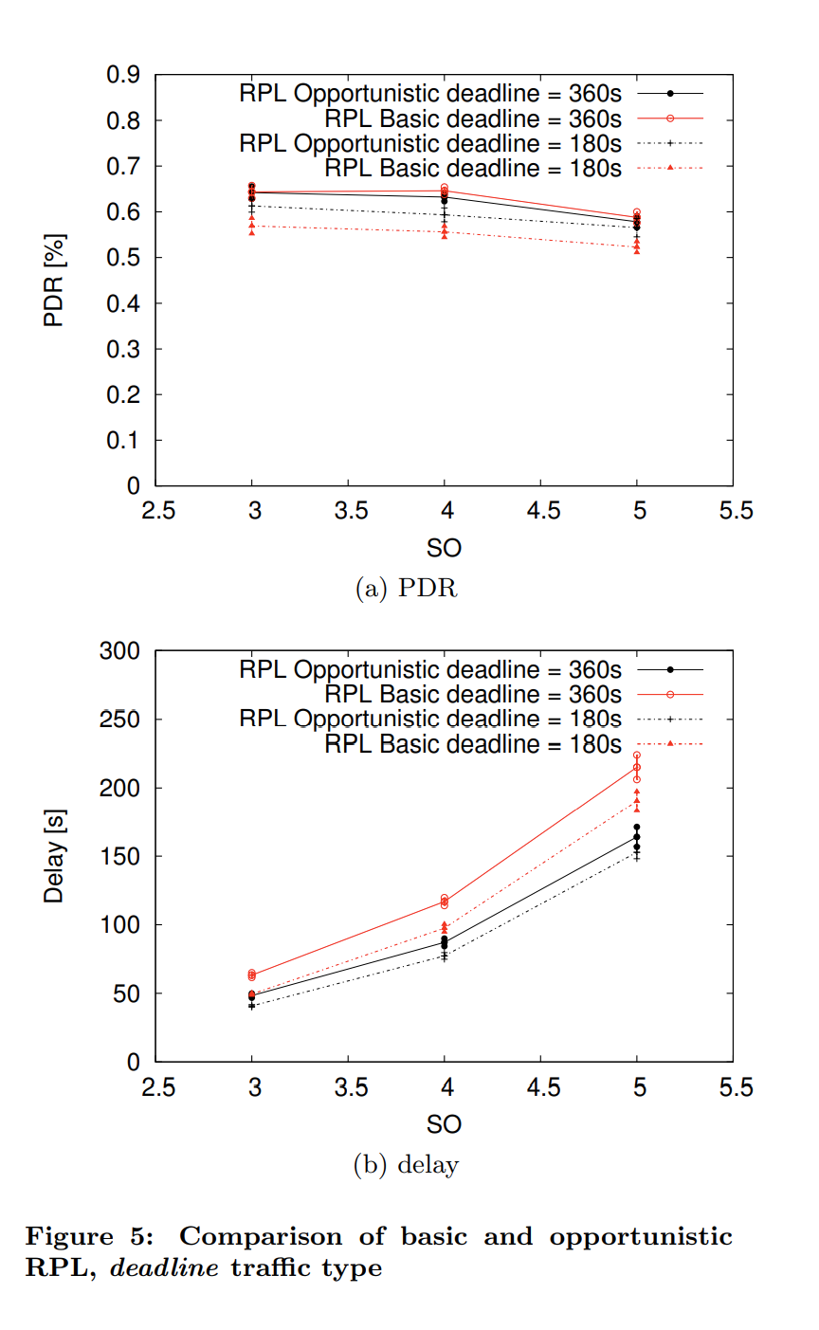
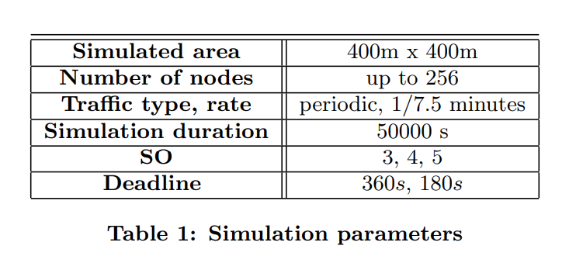
Evaluation
WSNet/Worldsens event-driven simulator
Contiki RPL/MAC 부분의 코드를 변경

Slide 16
Extra
몇 칸이 필요할까 ?
“we vary the SO parameter from 3 to 5 and choose the BO parameter so that the number of superframe slots is sufficient to avoid colliding superframes.”
+ Problem = Battery

Slide 17



Thank you!

